Slide 1
micro:bit
Student Worksheet
NAME: Thomas walsh
CLASS:

Slide 2
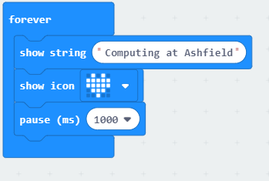
Lesson 1: Activity 1 Example Code
Create this code in your new micro:bit project
Run the program
Annotate the code below explain what you think each block does

Slide 3
Lesson 1: Activity 2 Bronze Challenge
Adapt the example script from Activity 1 to say something different and show a different image
Run the program
Paste a screenshot of your code on the next slide
Annotate the code below explain what you think each block does

Slide 4
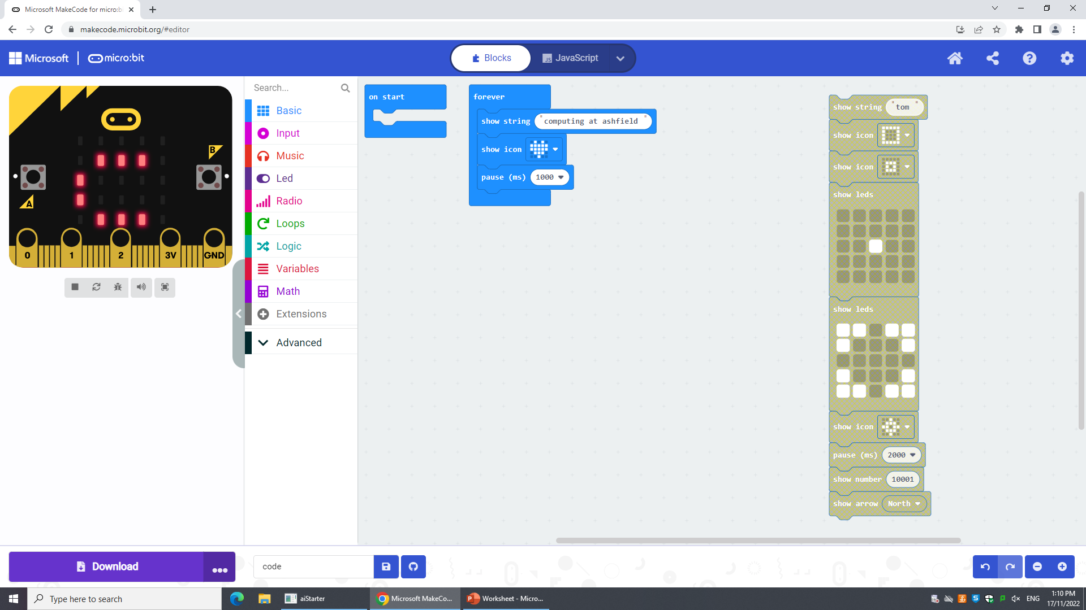
Lesson 1: Activity 2 Bronze Evidence Paste your screenshot and write your annotations on this slide for the Bronze Challenge
Screenshot
Annotations
I have said computing at ashfielld then showed a love half

Slide 5
Lesson 1: Activity 2 Silver Challenge
Write a program to do the following, and push it to your Micro:bit
Display your first name
Wait 1 second
Display an image
Wait 1 second
Display the text: "CompSci"
Wait 1 second
Run the program
Paste a screenshot of your code on the next slide
Annotate the code explain what you think each block does

Slide 6
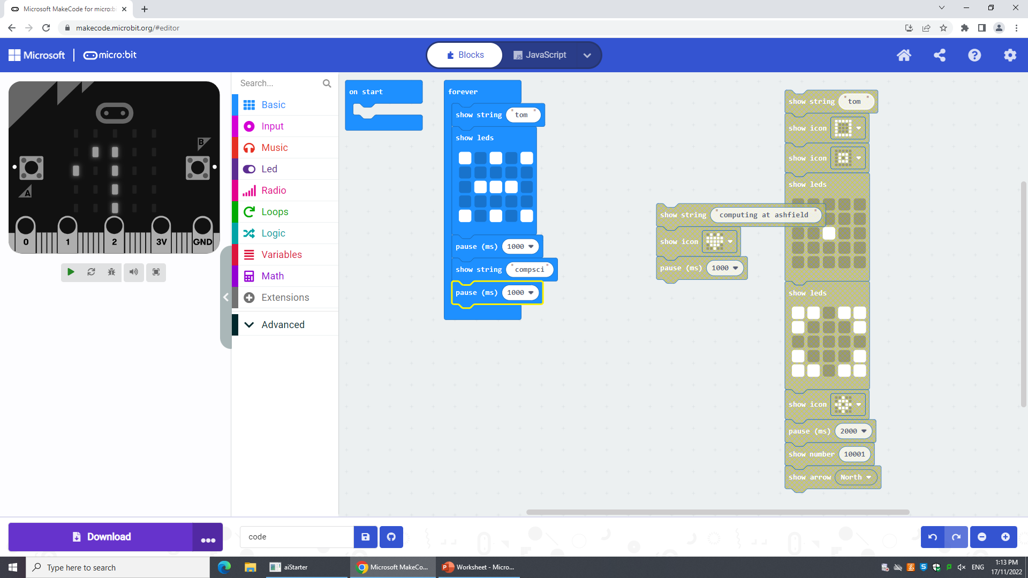
Lesson 1: Activity 2 Silver Evidence Paste your screenshot and write your annotations on this slide for the Silver Challenge
Screenshot
Annotations
I have done as it has sayed

Slide 7
Lesson 1: Activity 2 Gold Challenge
Write a program that has two different images and says two different things
Run the program
Paste a screenshot of your code on the next slide
Annotate the code explain what you think each block does

Slide 8
Lesson 1: Activity 2 Gold Evidence Paste your screenshot and write your annotations on this slide for the Gold Challenge
Screenshot
Annotations

Slide 9
Star Challenge: Lesson 1
Create your own micro:bit programs using just the Basic blocks.
Add these to this PowerPoint

Slide 10
Star Challenge: Lesson 1 Star Challenge Evidence Paste your screenshot and write your annotations on this slide for the Star Challenge
Screenshot
Annotations

Slide 11
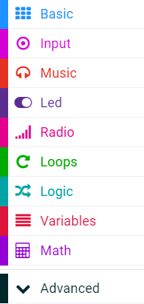

Help Guide 1: Variables
Go to:
https://makecode.microbit.org
Use Microsoft Edge
Making a variable in micro:bit is simple
Find Variables on the left hand side
Notes:
Teacher Notes:
- Go through this slide and the next slide as an explanation

Slide 12
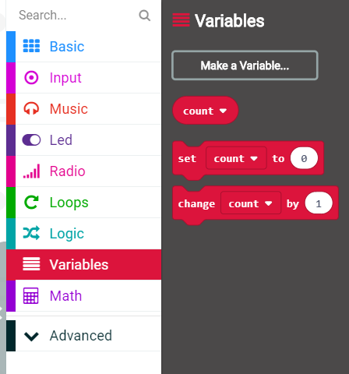
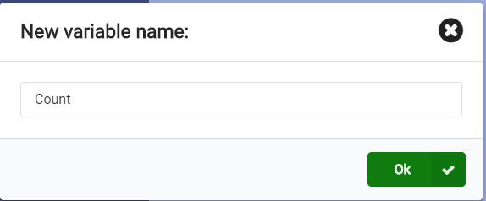
Help Guide 1: Variables
Then click on Make a Variable…
Give your Variable a sensible name such as Count and then press Ok
Notes:
Teacher Notes:
After going through this slide (and the previous slide)
Demonstrate the process to students to make the variable “Count”
Then let students create the variable themselves (give them 2 mins max before moving onto the next slide)
They need the variable “Count” for the first activity

Slide 13
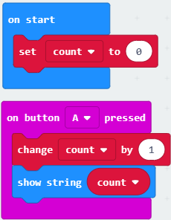
Lesson 2: Activity 1 Example Code
Create this code in your new micro:bit project
Run the program
Annotate the code below explain what you think each block does
Example Code
Annotations

Slide 14
Lesson 2: Activity 2 Bronze Challenge
Add to your code from Activity 1
Add a piece of code which makes the counter go down by 1 when Button B is pressed
Hint: You will need to add another on button pressed and change it from A to B
Run the program
Paste a screenshot of your code on the next slide
Annotate the code below explain what you think each block does

Slide 15
Lesson 2: Activity 2 Bronze Evidence Paste your screenshot and write your annotations on this slide for the Bronze Challenge
Screenshot
Annotations

Slide 16
Lesson 2: Activity 2 Silver Challenge
Adding to your Bronze code
Add a piece of code that doubles the counter when A and B are pressed together
Run the program
Paste a screenshot of your code on the next slide
Annotate the code explain what you think each block does

Slide 17
Lesson 2: Activity 2 Silver Evidence Paste your screenshot and write your annotations on this slide for the Silver Challenge
Screenshot
Annotations

Slide 18
Lesson 2: Activity 2 Gold Challenge
Adding to your Silver code
Add a piece of code that resets the counter to 0 when the Micro:Bit is shaken
Run the program
Paste a screenshot of your code on the next slide
Annotate the code explain what you think each block does

Slide 19
Lesson 2: Activity 2 Gold Evidence Paste your screenshot and write your annotations on this slide for the Gold Challenge
Screenshot
Annotations

Slide 20
Star Challenge: Lesson 2
Create 2 more programs that use the Button Pressed blocks
Could show different images
Could say different messages
Create 2 more programs that use a Variable

Slide 21
Star Challenge: Lesson 2 Star Challenge Evidence Paste your screenshot and write your annotations on this slide for the Star Challenge
Screenshot
Annotations

Slide 22
Lesson 3: Activity Bronze & Silver Challenges
Bronze Challenge
Silver Challenge
Create Rock, Paper, Scissors game following the tutorial
Save your program and screenshot your code/blocks
Run the program
Paste a screenshot of your code on the next slide
Annotate your code on the next slide highlighting the blocks that use Selection (Logic)
Annotate the code
Explain why you think selection is used

Slide 23
Lesson 3: Activity Bronze & Silver Evidence Paste your screenshot for the Bronze Challenge and write your annotations on this slide for the Silver Challenge
Bronze: Screenshot
Silver: Annotations

Slide 24
Lesson 3: Activity Gold Challenge
Create and annotate one of the following programs that uses Selection:
Coin Flipper
Snap the dot
Run the program
Paste a screenshot of your code on the next slide
Annotate the code explain what you think each block does

Slide 25
Lesson 3: Activity Gold Evidence Paste your screenshot and write your annotations on this slide for the Gold Challenge
Screenshot
Annotations

Slide 26
Star Challenge: Lesson 3
Create and annotate the other program from Gold that uses Selection e.g.
Coin Flipper
Snap the dot
Run the program
Paste a screenshot of your code on the next slide
Annotate the code explain what you think each block does

Slide 27
Star Challenge: Lesson 3 Star Challenge Evidence Paste your screenshot and write your annotations on this slide for the Star Challenge
Screenshot
Annotations

Slide 28
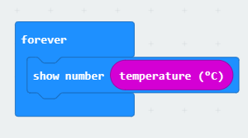
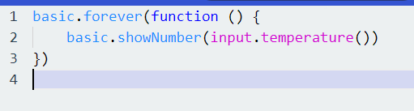
Lesson 4: Activity Bronze Challenge – Thermometer
Create this code in your new micro:bit project
Download it to your micro:bit
Run the program
Annotate the code below explain what you think each block does as well as explain what the program is for on the next slide

Slide 29
Lesson 4: Activity Bronze Evidence - Thermometer Paste your screenshot and write your annotations on this slide for the Bronze Challenge
Screenshot
Annotations

Slide 30
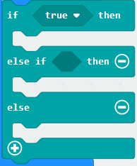

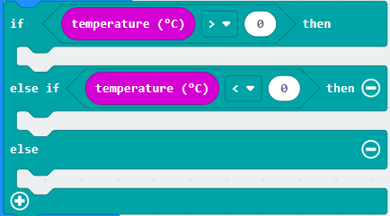
Lesson 4: Activity Silver Challenge 1 – Thermometer
Add to your Bronze Challenge to show a messages saying:
Hot - when the temperature is above 25
Cold - when the temperature is below 10
You may wish to use the Else If block and the Comparison blocks to help you

Slide 31
Lesson 4: Activity Silver Evidence 1 - Thermometer Paste your screenshot and write your annotations on this slide for the Silver 1 Challenge
Screenshot
Annotations

Slide 32
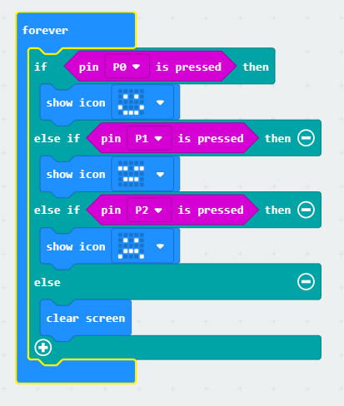
Lesson 4: Activity Silver Challenge 2 – Mood Meter
Copy the code and download it to your micro:bit
Change what Icons are displayed
See how the program works
Screenshot your code and annotate (write a description) what each block does as well as explain what the program is for on the next slide
To test the program, hold the GND pin with one hand, then touch the 0, 1 and 2 pins with a fingertip on the other hand

Slide 33
Lesson 4: Activity Silver Evidence 2 – Mood Meter Paste your screenshot and write your annotations on this slide for the Silver 2 Challenge
Screenshot
Annotations

Slide 34
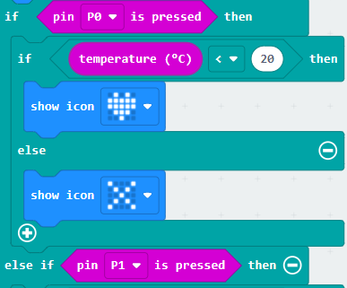
Lesson 4: Activity Gold Challenge 1 – Mood Meter
Add to your Mood Meter Code
Extend it so that the icon displayed for each Pin pressed is different based upon the temperature
You may need to look at your thermometer code
*This is an example of Nested Selection (Selection inside Selection)
An example of how to start off the Gold Challenge with Nested Selection

Slide 35
Lesson 4: Activity Gold Evidence 1 – Mood Meter Paste your screenshot and write your annotations on this slide for the Gold 1 Challenge
Screenshot
Annotations

Slide 36
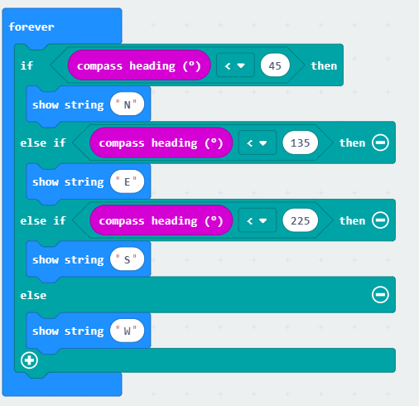
Lesson 4: Activity Gold Challenge 2 – Compass
Copy the code and download it to your micro:bit
See how the program works
Change the Show String to show an arrow that points in the right destination instead of the letters (N, E, S, W)
Screenshot your code and annotate (write a description) what each block does as well as explain what the program is for on the next slide
On the first use of the compass, the calibration procedure will automatically start. The user must draw a circle with the device until it is fully calibrated.

Slide 37
Lesson 4: Activity Gold Evidence 2 – Compass Paste your screenshot and write your annotations on this slide for the Gold 2 Challenge
Screenshot
Annotations

Slide 38
Star Challenge: Lesson 3
Create your own program that makes use of different input methods we have used today along with Selection (If, Else If, Else…)
E.g.
A more complex compass that shows NE, SE, SW & NW
Using the acceleration input to see how fast the micro:bit is moving

Slide 39
Star Challenge: Lesson 4 Star Challenge Evidence Paste your screenshot and write your annotations on this slide for the Star Challenge
Screenshot
Annotations

Slide 40
Star Challenge: Lesson 4 Star Challenge Evidence Paste your screenshot and write your annotations on this slide for the Star Challenge
Screenshot
Annotations

Slide 41
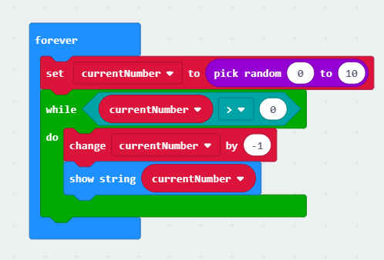
Lesson 5: Activity 1 Example Code
makecode.microbit.org
Create this code
Download it to your micro:bit
Add a screenshot of your code to the next slide (Using Snipping Tool)
Annotate and Explain what you think this code does…

Slide 42
Lesson 5: Activity 1 Evidence Paste your screenshot and write your annotations on this slide for Activity 1
Screenshot
Annotations

Slide 43
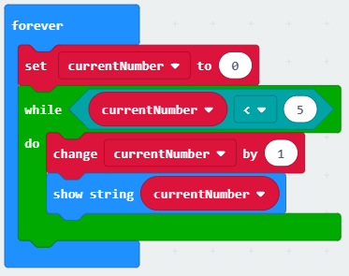
Lesson 5: Activity 2 Bronze Challenge
Copy the code that counts up to 5
Add to this code so it counts back down to 1, up to 5 again and so on repeatedly
Hint: You will just need to add another While Loop into this code

Slide 44
Lesson 5: Activity 2 Bronze Evidence Paste your screenshot and write your annotations on this slide for the Bronze Challenge
Screenshot
Annotations and Description

Slide 45
Lesson 5: Activity 2 Silver Challenge
Write a program where you shake the micro:bit to get a random number between 1 and 10 then count down
Hint: Instead of using the Forever block you will need to use a On Shake block

Slide 46
Lesson 5: Activity 2 Silver Evidence Paste your screenshot and write your annotations on this slide for the Silver Challenge
Screenshot
Annotations

Slide 47
Lesson 5: Activity 2 Gold Challenge
Write a program where you set the number (pressing A to go down and B to go up) then when you press A+B the micro:bit counts down.
Hint: You will have 3 separate blocks of code each one starting with a different On Button Press block

Slide 48
Lesson 5: Activity 2 Gold Evidence Paste your screenshot and write your annotations on this slide for the Gold Challenge
Screenshot
Annotations

Slide 49
Star Challenge: Lesson 5
Create at least 1 Game or Radio game out of the following:
Magic Button Trick
Snap the Dot
Tug-Of-LED
Crashy Bird (Golden Ticket)
Multi Dice (Radio Game)
Rock Paper Scissors Teams
Mood Radio

Slide 50
Star Challenge: Lesson 5 Star Challenge Evidence 1 Paste your screenshot and write your annotations on this slide for the Star Challenge
Screenshot
Annotations

Slide 51
Star Challenge: Lesson 5 Star Challenge Evidence 2 Paste your screenshot and write your annotations on this slide for the Star Challenge
Screenshot
Annotations

Slide 52
Star Challenge: Lesson 5 Star Challenge Evidence 3 Paste your screenshot and write your annotations on this slide for the Star Challenge
Screenshot
Annotations

